Slide 1
Ship control and classification
Professor Erik Røsæg
Nordisk institutt for sjørett
erik.rosag@jus.uio.no
folk.uio.no/erikro

Slide 2
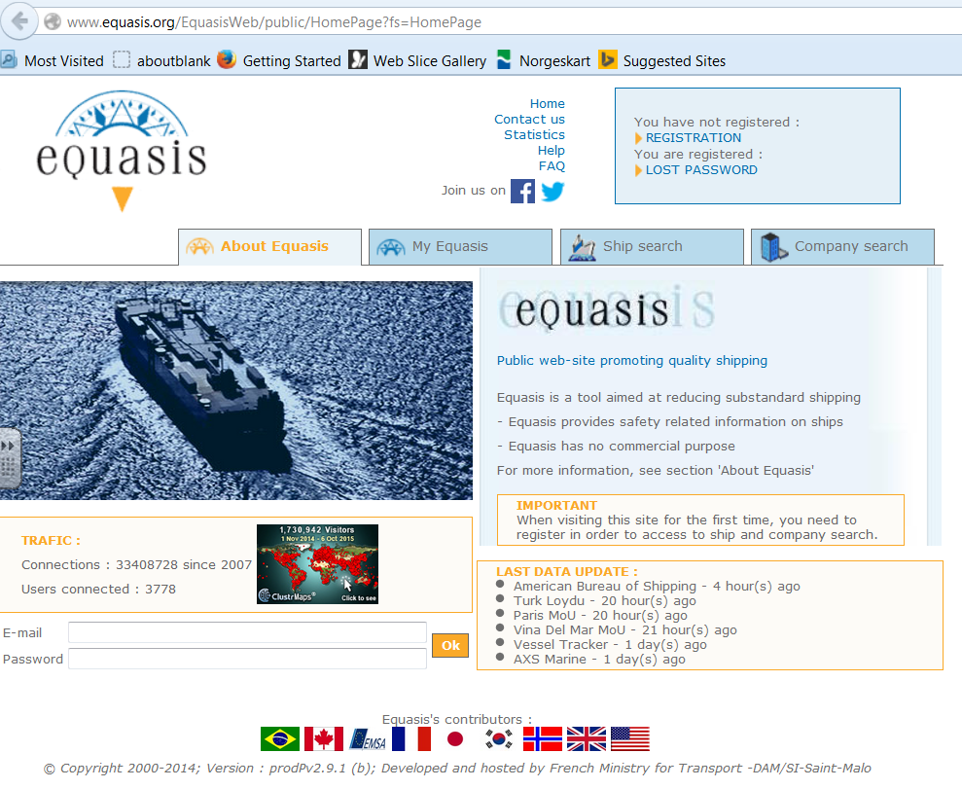

Slide 3
Some basic instruments
SOLAS
Torremolinos Convention
Marpol
Load Lines
STCW
ISPS
Paris Memorandum
ISM Code

Slide 4
Some general remarks on conventions
Tacit amendment
Grandfather clauses

Slide 5
SOLAS Regulation 3-2
Protective coatings of dedicated seawater ballast tanks in all types of ships and double-side skin spaces of bulk carriers
1 Paragraphs 2 and 4 of this regulation shall apply to ships of not less than 500 gross tonnage:
.1 for which the building contract is placed on or after 1 July 2008; or
.2 in the absence of a building contract, the keels of which are laid or which are at a similar stage of construction on or after 1 January 2009; or
.3 the delivery of which is on or after 1 July 2012.

Slide 6
Ballast Water Convention Art. 9
1 A ship to which this Convention applies may, in any port or offshore terminal of another
Party, be subject to inspection by officers duly authorized by that Party for the purpose of
determining whether the ship is in compliance with this Convention. Except as provided in
paragraph 2 of this Article, any such inspection is limited to:
(a) verifying that there is onboard a valid Certificate, which, if valid shall be
accepted; and
(b) inspection of the Ballast Water record book, and/or
(c) a sampling of the ship.s Ballast Water, carried out in accordance with the
guidelines to be developed by the Organization. However, the time required to
analyse the samples shall not be used as a basis for unduly delaying the operation,
movement or departure of the ship.
2 Where a ship does not carry a valid Certificate or there are clear grounds for believing
that:
(a) the condition of the ship or its equipment does not correspond substantially with
the particulars of the Certificate; or
(b) the master or the crew are not familiar with essential shipboard procedures
relating to Ballast Water Management, or have not implemented such procedures;
a detailed inspection may be carried out.

Slide 7
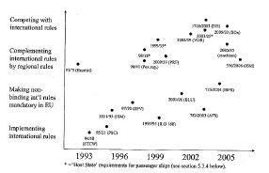
EU and EMSA
Erika packages
EU initiatives

Slide 8
Classification
Classification societies
Relationship to public authorities
Liability

Slide 9
Flags of Convenience
The issue
Safety culture?

Slide 10
Safety as a contractual term
Shipbuiding
Charterparties
Etc
Amended rules

Slide 11
Ship Safety Act
NMD
Responsible party
Investigation Board
Police

Slide 12
Sanctions
Administrative sanctions
Penal sanctions
Personal
Company
Forfeiture

Slide 13
Dangerous cargoes
The problem
Safety rules
Reporting

Slide 14
Port State Control
The basic principle
Host state control
Port of emergency
Ports of refuge
Creeping jurisdiction
GHG

Slide 15
Offshore safety
UNCLOS jurisdiction
National jurisdiction
Some observations of safety systems and cultures

